Slide 1
PC Maintenance: Preparing for A+ Certification
Chapter 4: The Motherboard

Slide 2
Chapter 4 Objectives
Understand the processing subsystem
Identify expansion buses and slots
Differentiate between motherboard form factors and feature sets
Identify parts of a motherboard
Change the battery in a motherboard
Troubleshoot motherboard problems

Slide 3
Processing Subsystem
Motherboard
CPU
Memory
Operating system

Slide 4
How a Motherboard Works
Buses
  Address bus
  System bus
  Expansion buses
Chips
  Chipset
  CPU
  RAM

Slide 5
Buses
Address bus: between CPU and MCC
  MCC: Memory controller chip
  Interfaces with RAM
System bus: between CPU and chipset
  Chipset: controller chip(s) on motherboard
Expansion buses: between chipset and expansion slots

Slide 6
Expansion Buses
AGP: Fastest, for video only
  32-bit, 66MHz up to 533MHz
PCI: Fast, general purpose
  32-bit, 33MHz
  New PCIe (PCI Express) is faster, will replace AGP soon
ISA: Slow, general purpose
  16-bit, 8MHz

Slide 7
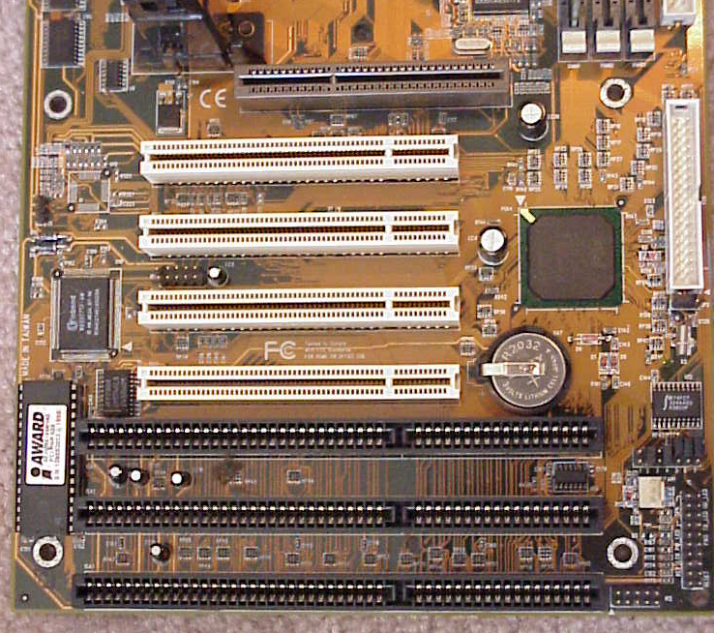
Expansion Slots
AGP
PCI
ISA

Slide 8
Motherboard Chipsets
North/South Bridge
  Older design
  Uses PCI bus to connect North (faster) and South (slower)
Hub
  Newer design
  PCI bus is separate, not used for north/south traffic
  Newer designs do not include ISA support

Slide 9
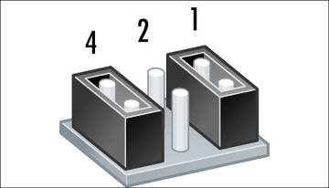
Jumpers
Two pins
When cap is placed over them, they are bridged and electrical circuit is created

Slide 10
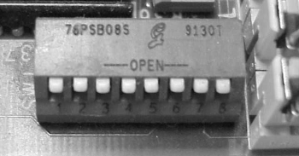
Switches
Tiny on/off switch that opens/closes electrical circuit
More expensive to manufacture than jumper

Slide 11
Selecting a Motherboard
Form Factor
Expansion Slots
RAM slots
CPU Slot or Socket
Built-in components (sound, video, network)
I/O ports (USB, FireWire, serial, parallel, PS/2 mouse)

Slide 12
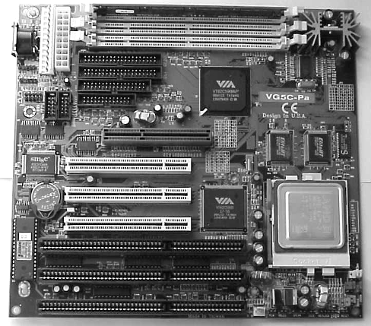
AT Motherboard
Large (AT-style) keyboard connector
Ports connect to case via small ribbon cables
AT-style power connector
Expansion slots parallel to wide edge
  Expansion slots parallel to wide edge
  Large (AT-style) keyboard connector
  AT-style power supply connector

Slide 13
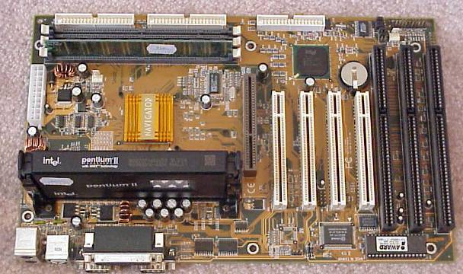
ATX Motherboard
ATX-style power supply connector
Expansion slots parallel to narrow edge
Small (PS/2) style keyboard connector
Ports built into side of board

Slide 14
Motherboard Expansion Slots
ISA: 16-bit, 8MHz
  Very old technology
  Slots are usually black
  Useful for compatibility with old devices

Slide 15
Motherboard Expansion Slots
PCI: 32-bit, 33MHz
  General-purpose expansion slots
  Slots are usually white
  Useful for a variety of cards including NICs, modems, sound cards

Slide 16
Motherboard Expansion Slots
AGP: 32-bit, 66MHz to 533MHz
  Only one per motherboard in most cases
  Slots are usually brown
  High speed for video card
  “X” ratings of speed, from 1X (66MHz) to 8X (533MHz)

Slide 17
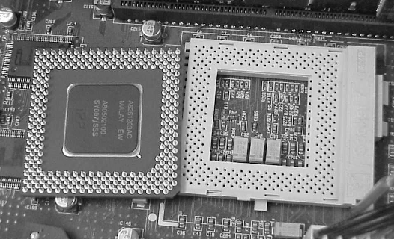
CPU Slot or Socket
Sockets for PGA CPUs
  Many styles of sockets with different number and arrangement of pins

Slide 18
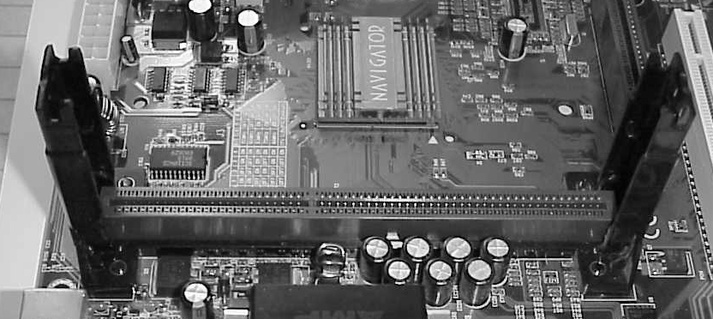
CPU Slot or Socket
Slots for cartridge-type (SECC) CPUs
  SECC Slot 1, Slot 2, Slot A

Slide 19
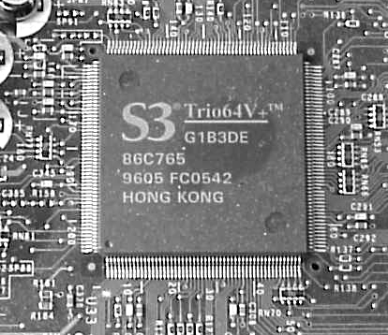
Built-in Components
Sound
Network
Video
Modem

Slide 20
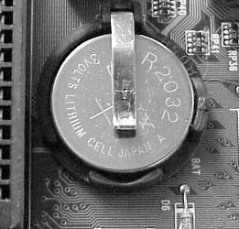
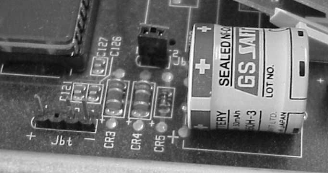
Battery
Why a battery?
  CMOS
  Real-time clock
Styles of battery
  Barrel
  Coin

Slide 21
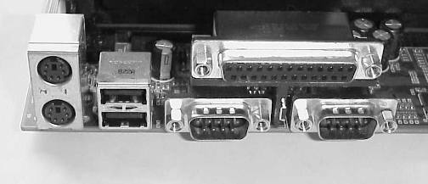
I/O Ports in Motherboard
USB
LPT (Legacy Parallel)
FireWire – less common
Mouse
Keyboard
COM (Legacy Serial)

Slide 22
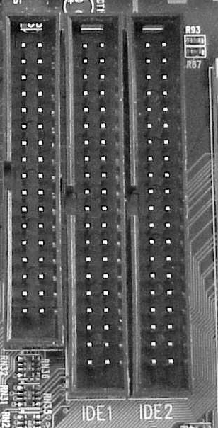
Drive Connectors on Motherboard
Floppy
  34-pin
  Ribbon cable
IDE
  40-pin
  Ribbon cable
  New type just introduced: Serial IDE

Slide 23
Troubleshooting Motherboards
Dead Motherboard:
  Correct CPU installed?
  Correct type of RAM?
  Power supply working?
  Video card installed?
  Power turned on?

Slide 24
Troubleshooting Motherboards
Beeping
  RAM, CPU, video card:
    Installed correctly?
    Appropriate for this motherboard?
    Malfunctioning?
  Look up beep code in BIOS reference

Slide 25
Troubleshooting Motherboards
Dead Battery
  Real-time clock is losing time
  PC forgets its configuration settings when powered off

Slide 26
Troubleshooting Motherboards
Dead built-in components
Malfunctioning expansion slots
Bad jumper settings
Bent pins
Leaky battery
Broken connection (poor soldering)
Short circuiting

